Slide 1
PROJECT
APPLICATION DEVELOPMENT PRACTICES
S SRIRAM CSE - C

Slide 2
PROJECT TOPIC
TOPIC OF THE PROJECT IS CREATING A DYNAMIC AND RESPONSIVE WEBPAGE USING HTML,CSS AND
JAVASCRIPT
TITLE OF MY PROJECT IS PERSONAL RESUME.

Slide 3
PROJECT DESCRIPTION
THE PROJECT OF PERSONAL RESUME IS CREATED WITH HTML CSS AND JAVASCRIPT
HTML - USED FOR SKELETON AND STATIC PROPERTIES OF WEBPAGE
CSS - USED FOR FORMATTING,BEAUTIFICATION AND RESPONSIVE WEBPAGE
JAVASCRIPT- USED FOR PRINTING AS PDF FUNCTION
PROJECT AIM - TO EXHIBIT EXPERIENCE AND ACHIEVEMENTS OF THE STUDENT IN AN INNOVATIVE WAY
BY STYLING A RESUME ON A WEBPAGE FOR GETTING AN EDGE IN PLACEMENTS FOR INTERNSHIPS AND FULL TIME JOBS.

Slide 4
SOURCE CODE
HTML AND INLINE JS:
<!DOCTYPE html>
<html>
<head>
<title>Resume</title>
<meta charset="UTF-8">
<meta name="viewport" content="width=device-width, initial-scale=1">

Slide 5
<link rel="stylesheet" href="https://cdnjs.cloudflare.com/ajax/libs/font-awesome/4.7.0/css/font-awesome.css"
integrity="sha512-5A8nwdMOWrSz20fDsjczgUidUBR8liPYU+WymTZP1lmY9G6Oc7HlZv156XqnsgNUzTyMefFTcsFH/tnJE/+xBg==" crossorigin="anonymous"
referrerpolicy="no-referrer" />
<link rel="stylesheet" type="text/css" href="styleres.css">
<link rel="icon" type="image/x-icon" href="/Users/sriram/Downloads/faviconio-logo/logo.png">
</head>
<body>
<div class="container">
<div class="left_side">
<div class="profiletext">
<div class="imagee">
<img src="/Users/sriram/Downloads/profpfp.jpeg">
</div>
<h2>Sriram Sundar<br><span>Freshman @ CIT</span></h2>
</div>
<div class="cinfo">
<h3 class="title">Contact Info</h3>

Slide 6
<ul>
<li>
<span class="icon"><i class="fa fa-phone" aria-hidden="true"></i></span>
<span class="text">+91 7010612106</span>
</li>
<li>
<span class="icon"><i class="fa fa-envelope" aria-hidden="true"></i></span>
<span class="text">sriramsu64@gmail.com</span>
</li>
<li>
<span class="icon"><i class="fa fa-github" aria-hidden="true"></i></span>
<span class="text"><a href="https://github.com/codetyri0n">Github Profile</span></a>
</li>
<li>
<span class="icon"><i class="fa fa-linkedin" aria-hidden="true"></i></span>
<span class="text"><a href="https://www.linkedin.com/in/sriram-sundararajan-2b3790228/" >Linkedin Profile</span></a>
</li>

Slide 7
<li>
<span class="icon"><i class="fa fa-map-marker" aria-hidden="true"></i></span>
<span class="text">Chennai,India</span>
</li>
</ul>
</div>
<div class="cinfo">
<h3 class="title">Education</h3>
<ul>
<li>
<span class="icon"><i class="fa fa-graduation-cap" aria-hidden="true"></i>
</span>
<span class="text"><h5>2022-2026</h5>
<h4>B.E. - CSE</h4>
</li>

Slide 8
<h4>CIT Chennai</h4></span>
</li>
<li>
<span class="icon"><i class="fa fa-pencil-square-o" aria-hidden="true"></i>
</span>
<span class="text"><h5>2022</h5>
<h4>High School Diploma</h4>
<h4>PSBB SSS K.K.Nagar</h4></span>
</li>
</ul>
</div>
<div class="cinfo">
<h3 class="title">Languages</h3>
<ul>
<li>
.

Slide 9
<span class="text">English</span>
<span class="percent">
<div style="width:90%;"></div>
</span>
</li>
<li>
<span class="text">Hindi</span>
<span class="percent">
<div style="width:70%;"></div>
</span>
</li>
<li>
</ul>
</div>
</div>

Slide 10
<span class="text">Tamil</span>
<span class="percent">
<div style="width:90%;"></div>
</span>
</li>
</ul>
</div
</div>

Slide 11
<div class="right_side">
<div class="about">
<h2 class="title2">Profile</h2>
<p>My name is Sriram Sundararajan and I am currently studying Computer Science Engineering at Chennai Institute of Technology
in Chennai.I am an avid programmer with interests in distributed systems and machine learning.I am also into competitive
programming and have hobbies such as gaming and playing cricket.
</p>
</div>
<div class="about">
<h2 class="title2">Experience</h2>
<div class="box">
<div class="year_company">
<h5>2023-</h5>
<h5>Center for Computational Modeling CIT</h5>
<div class="text">
<h4>Junior Research Associate</h4>
<p>Studied the general ebbs and flows of stock market and economy in India.<br>
Studied and experimented implementation of python using Monte Carlo Algorithm
to depict stock market incidents.</p>
.

Slide 12
</div>
</div>
</div>
<div class="box">
<div class="year_company">
<h5>2023-</h5>
<h5>bit space</h5>
<div class="text">
<h4>Head Admin</h4>
<p>Determining and evaluating project's practical,economical feasibility and benefits.<br>
Consult on internal matters and report to President and Vice President.<br>
Assign,manage and monitor tasks of Mentors,Content/PR Team.</p>

Slide 13
</div>
</div>
</div>
<div class="about skills">
<h2 class="title2">Professional Skills</h2>
<div class="box">
<h4>SQL<br>
Python<br>
C++<br>
C<br>
HTML<br>

Slide 14
CSS<br>
Javascript</h4>
</div>
</div>
<div class="extrac">
<h2 class="title2">Achievements</h2>
<div class="box">
<ul>
<li><p>IIT Madras Annual Quiz Regional Finalist(2021)<br></p></li>
<li><p>4th Division Cricketer(2021-)<br></p></li>
<li><p>U-14,U-16 School Cricket Captain</p></li>
</ul>
</div>

Slide 15
</div>
</div>
<button>Print Resume</button>
INLINE JAVASCRIPT:
<script>
var btn=document.querySelector("button");
btn.onclick=()=>{
window.print();
}
</script>

Slide 16
CSS
@import url("https://fonts.googleapis.com/css?family:system-ui:200,300,400,500,600,700,800,900&display=swap");
* {
margin: 0;
padding: 0;
box-sizing:border-box;
font-family:"system-ui",sans-serif;
}

Slide 17
body {
background: #fff;
display:flex;
justify-content: center;
align-items: center;
min-height: 100vh;
}
.container {
position: relative;
width: 100%;
max-width: 1000px; ;

Slide 18
min-height: 1000px;
background: #fff ;
margin: 50px;
display: grid;
grid-template-columns: 1fr 2fr;
box-shadow: 0 35px 55px rgba(0,0,0,0.1);
}
.container .left_side {
position: relative;
background: #a69feb;
padding: 40px;
}
.

Slide 19
.profiletext {
position: relative;
display: flex;
flex-direction: column;
align-items: center;
padding-bottom: 20px;
border-bottom: 1px solid rgba(255,255,255,0.2);
}
.profiletext .imagee {
position: relative;
width: 200px;

Slide 20
height: 200px;
border-radius: 50%;
overflow: hidden;
}
.profiletext .imagee img {
position: absolute;
top: 0;
left: 0;
width: 100%;
height: 100%;
object-fit: cover;

Slide 21
}
.profiletext h2 {
color:#fff;
font-size: 1.5em;
margin-top: 20px;
text-transform: uppercase;
text-align: center;
font-weight: 600;
line-height: 1.4em;
}
.

Slide 22
.profiletext h2 span {
font-size: 0.8em;
font-weight: 300;
}
a {
text-decoration: none;
}
a:visited {
text-decoration: none;
}
.cinfo {
padding-top: 40px;
}
.

Slide 23
.title {
color: #fff;
text-transform: uppercase;
font-weight: 600;
letter-spacing: 1px;
margin-bottom: 20px;
}
.cinfo ul {
position: relative;
}
.cinfo ul li {
position: relative;
margin: 10px 0;
cursor: pointer;
list-style: none;
}
.

Slide 24
.cinfo ul li .icon {
display: inline-block;
width: 30px;
font-size: 18px;
color: darkcyan;
}
.cinfo ul li span {
color: #0e31e38f;
font-weight: 300;
}
.cinfo .education li {
margin-bottom: 15px;
}
.cinfo .education h5 {
font-weight: 500;
}
.cinfo .education h4 {
font-weight: 300;
}
.cinfo .education h3 {
font-weight: 300;
}
.

Slide 25
.cinfo .language .percent {
position: relative;
width: 100%;
height: 6px;
display: block;
margin-top: 5px;
background: #081921;
}
.cinfo .language .percent div {
position: absolute;
top: 0;
left: 0;
height: 100%;
background: rgb(8, 14, 181);
}
.container .right_side {
position: relative;
background: #2fc8e0a9;
padding: 40px;
}
.about {
.

Slide 26
margin-bottom: 50px;
}
.about:last-child {
margin-bottom: 0;
}
.title2 {
color: rgba(176, 23, 23, 0.642);
letter-spacing: 1px;
margin-bottom: 10px;
text-transform: uppercase;
}
p {
color: #333;
}
.about .box {
display:flex;

Slide 27
flex-direction: row;
margin: 20px 0;
}
.about .box .year_company {
min-width: 150px;
}
.about .box .year_company h5 {
text-transform: uppercase;
color: #333;
font-weight: 600;

Slide 28
}
.about .box .text h4 {
text-transform: uppercase;
color: #333;
font-size: 16px;
}
.skills .box {
position: relative;
width: 100px;
display: grid;
grid-template-columns: 150px 1fr;
.

Slide 29
justify-content: center;
align-items: center;
}
.skills .box h4 {
text-transform: uppercase;
color: black;
font-weight: 500;
margin-left: 30px;
}
.extrac .box {
position: relative;

Slide 30
min-width: 200px;
display: grid;
grid-template-columns: 150px 1fr;
justify-content: center;
align-items: center;
}
.extrac .box p {
text-transform: uppercase;
color: black;
font-weight: 500;
margin-left: 30px;
margin: 20px;
}

Slide 31
@media (max-width: 1000px)
{
.container {
margin: 10px;
grid-template-columns: repeat(1,1fr);
}
}
@media(max-width: 600px) {
.about.box {
flex-direction: column;
}
.about .box .year_company {
margin-bottom: 5px;
}
}
.

Slide 32
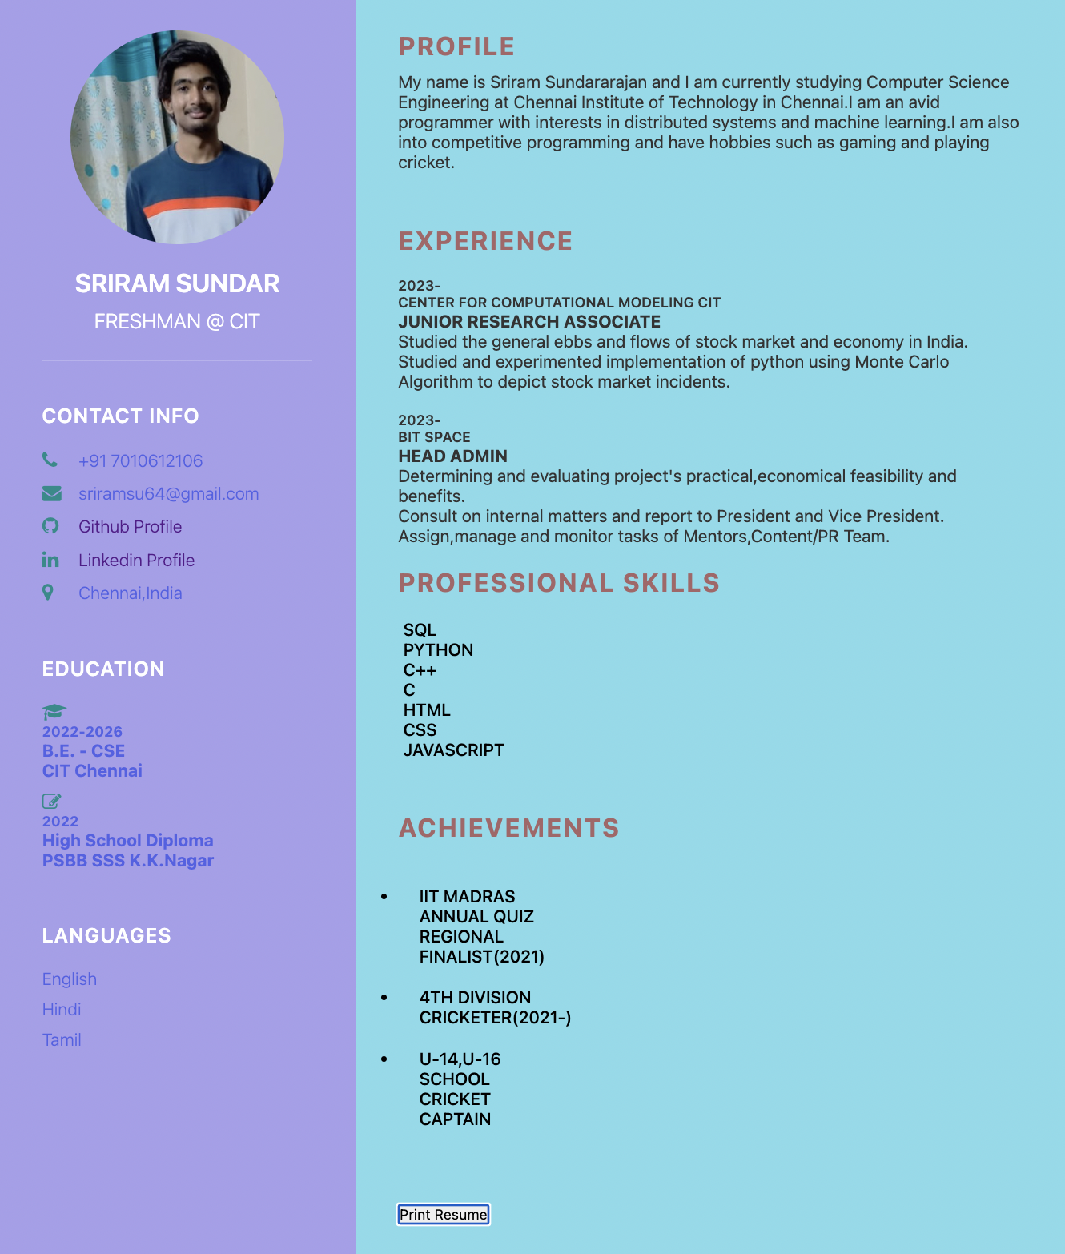
SAMPLE OUTPUT:

Slide 33
THANK YOU!
.

